Slide 1


Data Structures & Algorithms
Introduction to Programming
(Programme BSCS 1 2)
Mr. Martin Kubona
Department of Computing & Technology
Faculty of Engineering, Design & Technology
18th January 2023

Slide 2



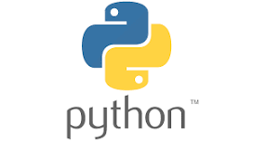



About Me ! ….. (Call me Martin)
Active & passionate Software Engineer in the Data Science domain. Other Hats for Passion: Linux, Security, Networks, Python.

Slide 3
Learning Outcomes
Learning Outcomes
To gain practical applicable experience using python to develop data structures and Algorithms.

Slide 4
Concepts to cover
1. Python Essentials
- Introduction to Python and Computer Programming
- Data Types, variables, Input-output operations, basic operations
- Boolean values, conditional executions, loops, lists and list processiong, logical and bitwise operations
- Functions, tuples, dictionaries and data processing
- Strings,
- Exceptions
- Object Oriented Programming
2. Data Structures
3. Algorithms

Slide 5
Nice to Learn/have Skills
Linux
Version Control using Git
Github Account

Slide 6
Getting Started
Have a working COMPUTER with Min Specs
I3 Processor, 500GB HDD/128 SSD, 4 GB RAM.
Install Python3 from the official Site.
[Optional] - Have Linux
Fully Fledged Installation ( Ubuntu22+ etc )
WSL2 for windows 10+ users
Consistently Program everyday and commit progress to GitHub

Slide 7
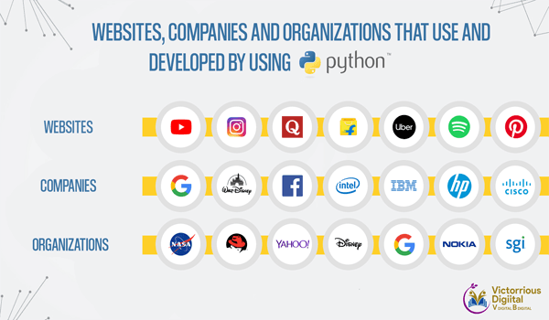
Why Python??
Learning is fun, trendy, easy to use.
Easy to use to write software
Easy to get, install and deploy
Free

Slide 8
Why Python ( Use cases )
Web and Internet Development.
Scientific and Numeric Computing
Education
Desktop GUI
Software Development.
Business Applications
Many more

Slide 9
First Steps
Disclaimer::
This is not a language course! You are expected you to master the language in your own time.
We will go over concepts of the language
Continual Everyday Practice makes you a better Python Programmer
Start Here : https://docs.python.org/3/tutorial/index.html
Make Projects to apply skills you have learned.
We will use this https://github.com/MartinKayz/Data-Structures-Algorithms-in-Python as our Central Repository for Tutorials

Slide 10
Writing our first Program
Ways to Launch Python
IDLE (Integrated Development Learning Environment )
Terminal
VS Code

Slide 11
Assignment
Create GitHub Accounts
Share your details using this Google Form
https://forms.gle/5JMSUNH59cKLz3Hx6

Slide 12

Questions
????

